Slide 1

FIRE AND SMOKE ALARM SYSTEM
St. Francis Institute of Technology
Department of Information Technology
SNL Mini Project (ITL604)
Academic Year 2020/21
PRITHVI SHETTY ROLL NO. 01
SHITAANSHU SINGH ROLL NO. 02
NISHIT THAKKAR ROLL NO. 03
NELKIN ELDHO ROLL NO. 04
Mentor: Mrinmoyee Mukherjee
DOP- 13/05/21

Slide 2
Outline
Introduction
Literature survey
Research gaps
Problem statement and solution
System design
Novelty
Circuit diagram
System requirements
Outputs
Conclusion
Future Scope and Applications
References

Slide 3
Introduction
A Wireless sensor network can be defined as a network of devices that can communicate the information gathered from a monitored field through wireless links.
In a metropolitan city like Mumbai with the presence of large of number of people , homes poses a huge fire threat due to negligence and also with so many inflammable items –upholstery , decorative material , gas leaks and electrical gadgets among others
1

Slide 4
Introduction
India has lost 60,607 lives during the period 2015-18 of which 56% were accounted for home/residential fire.(ADSI).Thus residential fire becoming the largest source of fatalities [1].
Fire alarm and detection technology should help to detect fire at sufficiently early stage so that it can help to reduce the damage to human life and property
2

Slide 5
Literature Survey
Ref.no. | Abstract | Advantages | Disadvantages
2 | Gas sensor (MQ-05),Bluetooth module and Arduino is used for detection of fire and gas. | Design is cost effective | Only mq-05 sensor is used.
3 | DHT 11 sensor which is connected to internet to monitor temperature and humidity rate | Design and implementation of fire detection is customizable and flexible | Sensor doesn't has higher range coverage.
3

Slide 6
Literature Survey
Ref no. | Abstract | Advantages | Disadvantages
4 | A node system is used where a node contains two sensor and Ethernet connecting to a ZigBee connection. As soon as fire and smoke are detected it is transmitted to the nearest node and a message is sent to the cloud. | Using ZigBee connection, it can be monitored anytime. | This system is expensive to implement.
5 | GSM based fire alarm system uses GSM module , Arduino , LCD and LM35 as main temperature sensor | Easy implementation , maximum reliability , user friendly and low cost which could be used for home and industrial security system | The system is not fire proofed.
4

Slide 7
Research Gaps
[2] Multiple sensors can be added to improve the efficiency of the system
[3] LM35 sensor is more precise.
[4] System can be optimized to make it more user friendly.
[5] GSM relies on strong network to communicate and in slower network can be unreliable.
5

Slide 8
Problem Statement & Problem Solution
PROBLEM STATEMENT
To develop a Bluetooth based fire detection system which can be used for houses and residential places to detect fire and alert the residents .
PROBLEM SOLUTION The system will use MQ2 sensor(smoke sensor) and flame sensor in combination for reliability and dependability.
The system will notify using a buzzer which will go off as soon as smoke or fire is detected.
6

Slide 9
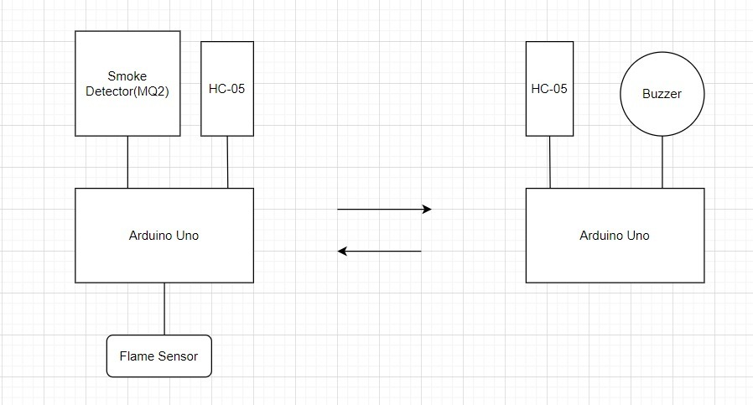
System Design
Transmitter side
Receiver side
7

Slide 10
Novelty of the project
System raises alarm sound through the Buzzer.
Instead of using Wi-Fi or GSM technologies we make use of PAN technology i.e. IEEE 802.15.1(Bluetooth module) for Communication.
8

Slide 11

Circuit Diagram
Bluetooth HC-05
IR flame sensor
MQ-2 Smoke sensor
Breadboard
Arduino Uno
Transmitter side
9

Slide 12

Circuit Diagram (Contd…)
Bluetooth HC-05
Buzzer
Breadboard
Arduino Uno
Receiver side
10

Slide 13
Pin Configuration
Bluetooth HC-05 (Master)
Smoke sensor (MQ-2)
Arduino uno pin | HC-05 pin
Tx | Rx
Rx | Tx
5V | Vcc
Gnd | Gnd
Arduino uno pin | HC-05 pin
A1 | A0
5V | Vcc
Gnd | Gnd
Bluetooth HC-05 (Slave)
Piezo electric buzzer
Arduino uno pin | HC-05 pin
Tx | Rx
Rx | Tx
5V | Vcc
Gnd | Gnd
Arduino uno pin | Piezo buzzer
Gnd | Negative potential
D9 | Positive potential
11

Slide 14
System Requirements
Hardware requirements with cost
Sr. No | Name of Component | Price per unit (INR) | No. of units | Total price (INR)
1 | HC-05 Bluetooth Module | 350 | 2 | 700
2 | Breadboard | 100 | 2 | 200
3 | Jumper wires | 4 | 15 | 60
4 | MQ 2 Sensor | 225 | 1 | 225
5 | Flame sensor | 25 | 1 | 25
6 | Resistor 1k ohm | 3 | 1 | 3
9 | Buzzer | 50 | 2 | 100
10 | Transistor | 20 | 1 | 20
11 | Arduino uno | 450 | 2 | 900
Total Cost (INR) |  |  |  | 2233
INR : Indian Rupee
12

Slide 15
System Requirements
Software Requirements
Arduino IDE.
Windows 7 and above OS.
13

Slide 16
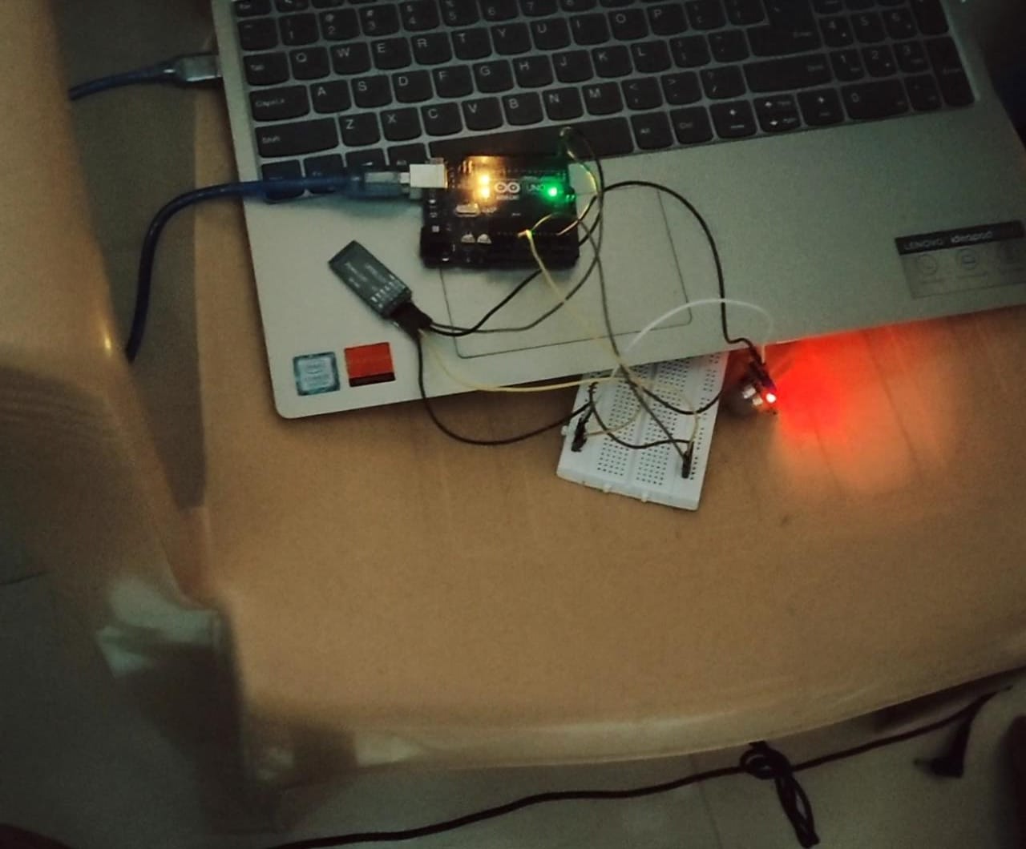
Output (Transmitter)
14

Slide 17
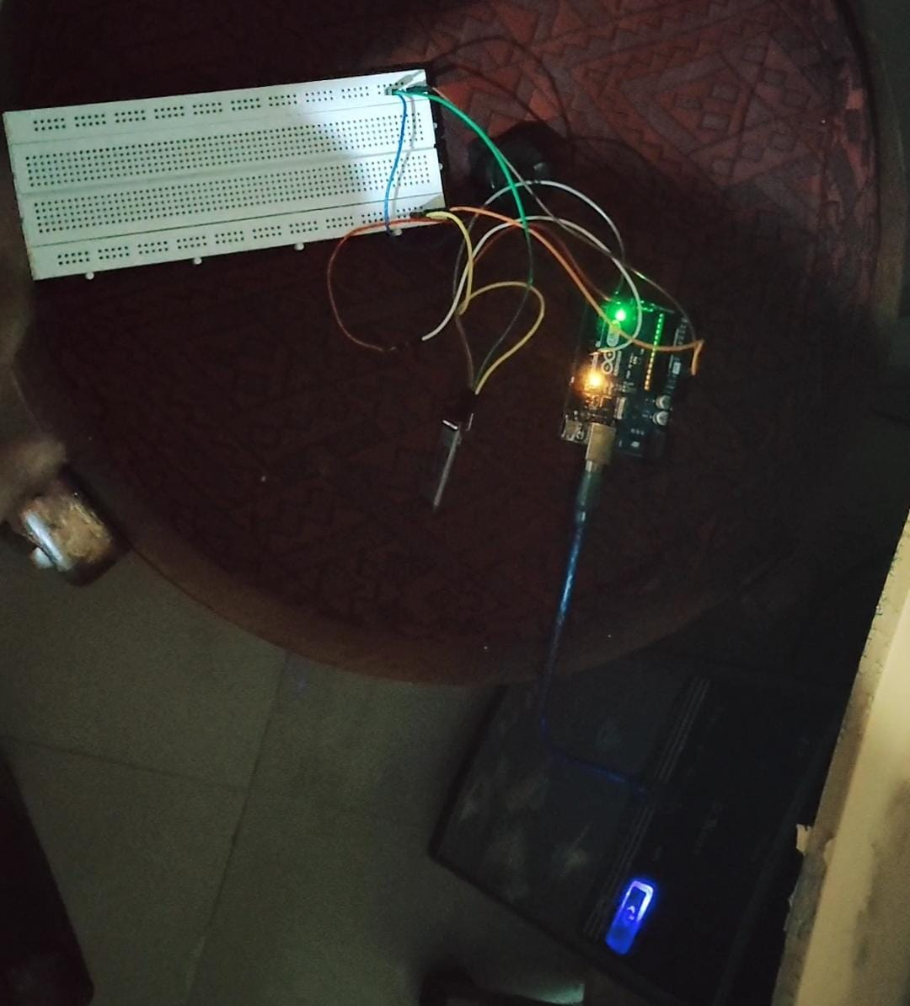
Output (Receiver)
15

Slide 18

Demo
https://youtu.be/AwuAR1vYzOg
16

Slide 19
Conclusion
We have developed a fire alarm system using Arduino, flame sensor and smoke sensor.
The system uses Bluetooth module to suffice the need of wireless communication.
The developed prototype will use reliable instruments that will be suitable to develop a fire detector and it is an eco-friendly design
The System can be utilized in houses, warehouses and gas stations.
17

Slide 20
Future Scope and Application
This system can be used to alert fire and smoke at an early stage.
The system can be helpful in houses, warehouses and gas stations to prevent loss of life and property due to fire.
The system can be further upgraded to be used in large scale by adding more technologies.
18

Slide 21
References
[1] https://www.news18.com/news/opinion/how-far-are-we-from-making-our-country-fire-safe-2486987.html
[2] P.Pushpa, T.Sudheer Kumar, P.Bhulaxmi, “Detection of fire and gas using Arduino and Bluetooth module” International Journal of Engineering Research & Technology (IJERT) 2020 (Volume: 07 Issue: 01)
[3] Dr. Abdul Khaleq, Noor & Khalaf, Osamah & Addulsahib, “IOT fire detection system using sensor with Arduino”, International Journal of Electrical and Electronics Research, vol. III, pp. 264-269, 2015.
[4] P.S. Jadhav , V.U. Deshmukh, “Forest Fire Monitoring System Based On ZIG-BEE Wireless Sensor Network”,International Journal of Emerging Technology and Advanced Engineering,(Volume 2, Issue 12, December 2012)
[5] Dhurvajyothi Paul ,Arnab Ghosh ,Soumya Jyothi Banerjee(2016). “GSM Based Fire Sensor Alarm Using Arduino”, September 08, 2020, from International Journal of Scientific & Engineering Research.(Volume 7,Issue 4)
19

Slide 22
Thank You!

